Slide 1
Java static keyword
The static keyword in Java is used for memory management mainly.
We can apply java static keyword with variables, methods, blocks and nested class.
The static keyword belongs to the class not to the instance of the class.

Slide 2
Static Variable
It is a variable which belongs to the class and not to object(instance).
Static variables are initialized only once, at the start of the execution.
These variables will be initialized first, before the initialization of any instance variables.
A single copy to be shared by all instances of the class.
for example, the company name of employees, college name of students, etc.
A static variable can be accessed directly by the class name and doesn’t need any object.
Syntax: <class-name>.<variable-name>

Slide 3
class Counter{
int count=0; //will get memory each time when the instance is created
Counter(){
count++; //incrementing value
System.out.println(count);
}
public static void main(String args[]){
//Creating objects
Counter c1=new Counter();
Counter c2=new Counter();
Counter c3=new Counter();
}
Output: 1
1
1

Slide 4
Using static variable
class Counter2{
static int count=0; //will get memory only once and retain its value
Counter2(){
count++; //incrementing the value of static variable
System.out.println(count);
}
public static void main(String args[]){
//creating objects
Counter2 c1=new Counter2();
Counter2 c2=new Counter2();
Counter2 c3=new Counter2();
}
}
Output: 1
2
3

Slide 5
Java static method
If we apply static keyword with any method, it is known as static method.
It is a method which belongs to the class and not to the object(instance).
A static method can access only static data.
It can not access non-static data (instance variables).
A static method can call only other static methods and can not call a non-static method from it.
A static method can be accessed directly by the class name and doesn’t need any object.
A static method cannot refer to "this" or "super" keywords in anyway.
Syntax: <class-name>.<method-name>

Slide 6
class Student{
int rollno;
String name;
static String college;
//static method to change the value of static variable
static void change(){
college = “Silicon University";
}
//constructor to initialize the variable
Student(int r, String n){
rollno = r;
name = n;
}

Slide 7
void display()
{
System.out.println(rollno+" "+name+" "+college);
}
}
//Test class to create and display the values of object
public class TestStaticMethod{
public static void main(String args[]){
Student.change();//calling change method
//creating objects
Student s1 = new Student(111,"Karan");
Student s2 = new Student(222,"Aryan");
Student s3 = new Student(333,"Sonu");
//calling display method
s1.display();
s2.display();
s3.display();
}
}

Slide 8
Restrictions for the static method
There are two main restrictions for the static method. They are:
The static method can not use non static data member or call non-static method directly.
this and super cannot be used in static context.

Slide 9
Why is the Java main method static?
It is because the object is not required to call a static method.
If it were a non-static method, JVM creates an object first then call main() method that will lead the problem of extra memory allocation.

Slide 10
Java static block
The static block is a block of statement inside a Java class that will be executed when a class is first loaded into the JVM.
A static block helps to initialize the static data members, just like constructors help to initialize instance members.
It is executed before the main method at the time of class loading.

Slide 11
Example
class A2{
static
{
System.out.println("static block is invoked");
}
public static void main(String args[]){
System.out.println("Hello main");
}
}
Output:
Static block is invoked
Hello main

Slide 12
Example
class Start
{
static int a;
static int b;
static {
a = 10;
b = 20;
}
public static void main(String args[]) {
System.out.println("Value of a = " + a);
System.out.println("Value of b = " + b);
}
}

Slide 13
Unit-II
(Inheritance & Polymerphism)

Slide 14
Inheritance
●It is the process of creating new classes from existing classes.
●The new class is called derived class/subclass/child class, where as the existing class is called base class/superclass/parent class.
●Through inheritance, code reusability and method overriding are achieved.
●It represents is-a relationship.
Syntax:
class Subclass-name extends Superclass-name
{
//methods and fields
}
The extends keyword indicates that we are making a new class that derives from an existing class.

Slide 15
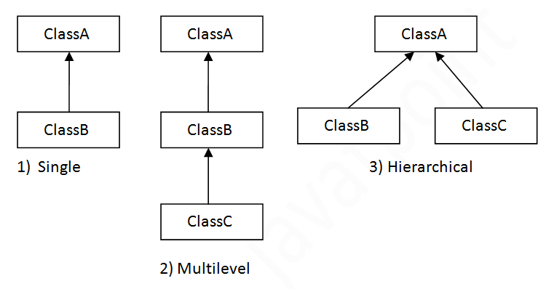
Types of Inheritance
In Java there are three types of inheritance possible single, Multilevel and Hierarchical.

Slide 16
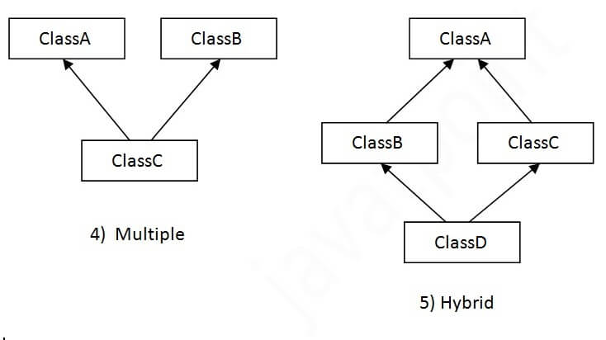
The multiple inheritance and hybrid inheritance are only possible through interface not supported through class.

Slide 17
Advantages of Inheritance
1. Code Reusability
Common logic can be written once in a parent (superclass) and reused by child (subclasses), avoiding duplication.
2. Method Overriding (Runtime Polymorphism)
Child classes can override parent methods, allowing flexibility and dynamic behavior at runtime.
3. Improved Code Maintenance
Since reusable code resides in the parent class, changes need to be made only once, reducing maintenance effort.
4. Abstraction Support
Inheritance works hand-in-hand with abstract classes, enabling the creation of generalized structures and specialized implementations.
5. Readability and Structure
Organizes code in a hierarchical manner, making it easier to understand relationships between classes.

Slide 18
Disadvantages of Inheritance
1. Tight Coupling
Child classes are dependent on parent classes. If the parent changes, child classes may break.
2. Difficulty in Code Understanding
Deep inheritance chains make it hard to trace functionality, leading to complexity.
3. Potential for Misuse
Inheriting just to reuse code (without a proper IS-A relationship) leads to poor design and maintenance problems.
4. Performance Overhead
Method calls in inheritance (especially with overriding and polymorphism) may be slightly slower compared to non-inherited calls.
5. Increased Testing Effort
Since subclasses rely on super classes, changes in parent logic require extensive testing of all subclasses.

Slide 19
Single Inheritance
When a single class is created from an existing class that process is called single inheritance.
Example:
class Animal{
void eat()
{
System.out.println("eating...");}
}
class Dog extends Animal{
void bark()
{
System.out.println("barking...");
}
}
class TestInheritance{
public static void main(String args[]){
Dog d=new Dog();
d.bark();
d.eat(); }
}
Output: barking…
eating…

Slide 20
Multilevel Inheritance
In this type of inheritance, a derived class is used as a base class to create a new class.
Example:
class Animal{
void eat()
{
System.out.println("eating...");
}
}
class Dog extends Animal{
void bark()
{
System.out.println("barking...");
}
}
class BabyDog extends Dog{
void weep()
{
System.out.println(“weeping...");
}}

Slide 21
class TestInheritance2
{
public static void main(String args[])
{
BabyDog d=new BabyDog();
d.weep();
d.bark();
d.eat();
}
}
Output: weeping…
barking…
eating…

Slide 22
Hierarchical Inheritance
When two or more classes are used to derive a new class that type of inheritance is called hierarchical inheritance.
Example:
class Animal
{
//code
}
class Dog extends Animal
{
//code
}
class Cat extends Animal
{
//code
}

Slide 23
Super Keyword in Java
The super keyword acts as a reference variable which always refers to the immediate parent class object.
When the instance of a subclass is created at that moment, an instance of parent class is also created automatically. This is referred to as the super reference variable.
Through super keyword, we can refer to the immediate parent class instance variable. We can also invoke the immediate parent class method, and super() can be used to invoke the immediate parent class constructor.

Slide 24
Use of Super to Refer Immediate Parent Class Instance Variable
If parent class and child class have same data members then, super keyword can be used to differentiate the parent class members from child classes.
Example:
class Animal{
String color="white";
}
class Dog extends Animal{
String color="black";
void printColor(){
System.out.println(color);//prints color of Dog class
System.out.println(super.color);//prints color of Animal class
}
}
class TestSuper1{
public static void main(String args[]){
Dog d=new Dog();
d.printColor();
}}
Output: black
white

Slide 25
Use of Super to Invoke Parent Class Method
If subclass contains the same method as parent class i.e, if method is overridden. Then, the super keyword is used to call the parent class methods.
Example:
class Animal{
void eat(){System.out.println("eating...");}
}
class Dog extends Animal{
void eat(){System.out.println("eating bread...");}
void bark(){System.out.println("barking...");}
void work(){
super.eat();
bark();
}
}
class TestSuper2{
public static void main(String args[]){
Dog d=new Dog();
d.work();
}}
Output: eating…
barking…

Slide 26
Use of Super to Invoke Parent Class Constructor
During inheritance, to invoke the parent class constructor super keyword is used.
Example:
class Animal{
Animal(){System.out.println("animal is created");}
}
class Dog extends Animal{
Dog(){
super();
System.out.println("dog is created");
}
}
class TestSuper3{
public static void main(String args[]){
Dog d=new Dog();
}
}
Output: animal is created
dog is created

Slide 27
Abstract Class
A class which is declared with the abstract keyword is known as an abstract class.
Example: abstract class A{}
Abstract class provides a foundation upon which other sub classes are built.
It can contain both abstract and non-abstract methods (method with the body).
An abstract class needs to be extended in order to implement the abstract methods declared within it.
It cannot be instantiated.
It can also contain constructors and static methods.
It can have final methods which will force the subclass not to change the body of the method.
There are two ways to achieve abstraction in Java such as: through the abstract class and through interface.

Slide 28
Abstract Method
An abstract method is declared with the keyword abstract.
It can only be present inside an abstract class.
It does not have implementation.
The method is defined inside the subclass.
Syntax
abstract void printStatus();

Slide 29
Example1:
abstract class Bike
{
abstract void run();
}
class Honda4 extends Bike
{
void run()
{
System.out.println("running safely");
}
public static void main(String args[])
{
Bike obj = new Honda4();
obj.run();
}
}
Note:
In this example, Bike is an abstract class that contains only one abstract method run. Its implementation is provided by the Honda class. Here, obj is a reference to the subclass object Honda4.

Slide 30
Example2:
abstract class Shape{
abstract void draw();
}
class Rectangle extends Shape{
void draw(){System.out.println("drawing rectangle");}
}
class Circle1 extends Shape{
void draw(){System.out.println("drawing circle");}
}
class TestAbstraction1{
public static void main(String args[]){
Shape s=new Circle1();
s.draw();
}
}

Slide 31
Interface in Java
Like a class, an interface can also contains methods and variables within it, but the methods declared in an interface are by default abstract (only method signature, no body).
Interfaces mention what a class must do and not how to do. If a class implements an interface and does not provide method bodies for all functions specified in the interface, then the class must be declared abstract.
It is used to achieve abstraction and multiple inheritance in Java.
The Java compiler adds public and abstract keywords before the interface method. Moreover, it adds public, static and final keywords before data members.
Syntax :
interface <interface_name> {
// declare constant fields
// declare methods that abstract by default.
}

Slide 32
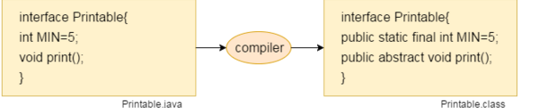

Slide 33
Example:
interface Player
{
final int id = 10;
int move();
}
Interfaces can only contain method declaration.
A class that implements an interface (a subclass) must implement all the methods declared in the interface.
To implement interface use implements keyword.

Slide 34
Example:
import java.io.*;
interface In1
{
final int a = 10;
void display();
}
class TestClass implements In1
{
public void display()
{
System.out.println("Geek");
}
public static void main (String[] args)
{
TestClass t = new TestClass();
t.display();
System.out.println(a);
}
}
Output:
Geek
10

Slide 35
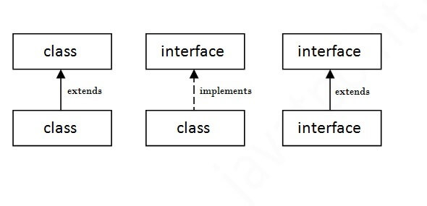
The Relationship Between Classes and Interfaces
As shown in the figure given below, a class extends another class, an interface extends another interface, but a class implements an interface.

Slide 36
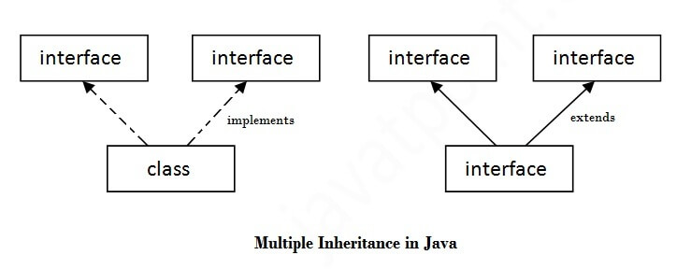
Multiple Inheritance in Java by Interface
If a class implements multiple interfaces, or an interface extends multiple interfaces, it is known as multiple inheritance.

Slide 37
Example:
interface Printable{ void print(); }
interface Showable{ void show(); }
class A7 implements Printable, Showable
{
public void print()
{
System.out.println("Hello");
}
public void show()
{
System.out.println("Welcome");
}
public static void main(String args[])
{
A7 obj = new A7();
obj.print();
obj.show();
}
}
Output:
Hello
Welcome

Slide 38
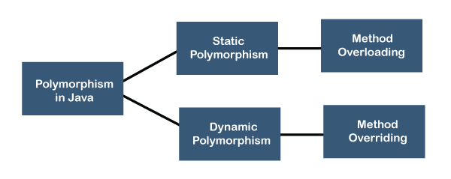
Polymorphism in Java
There are two types of polymorphism in Java such as: Static and Dynamic Polymorphism.

Slide 39
Dynamic Polymorphism in Java
Dynamic Polymorphism
In this mechanism, the execution of an overridden method is done at runtime. It is also known as runtime polymorphism or dynamic method dispatch. We can achieve dynamic polymorphism by using method overriding.
Properties of Dynamic Polymorphism
It decides which method is to execute at runtime.
It is achieved through dynamic binding.
It happens between different classes.
It is required where a subclass object is assigned to a super-class object for dynamic polymorphism.

Slide 40
Method Overriding
It is used to achieve runtime polymorphism. It gives a specific implementation to a method that is present in the parent class. The main() method and any of the static methods can not be overridden.
Rules for Method Overriding
The method name must be the same in the parent as well as child class.
The number of parameters and the types must be the same in both classes.
There must exist an IS-A relationship (inheritance).
We call an overridden method through a reference of the parent class. The type of object decides which method is to be executed at runtime by JVM.

Slide 41
Advantages of Method Overriding
●When a class has several child classes, a child class wants to use the parent class method. It can use it, and the other classes can have different implementations of the method.
●By method overriding, they can make changes without touching the parent class code.

Slide 42
Example1:
class Parent
{
public void display()
{
System.out.println("Overridden Method");
}
}
public class Child extends Parent
{
public void display()
{
System.out.println("Overriding Method");
}
public static void main(String args[])
{
Child obj=new Child();
obj.display(); }
}
Note:
In the example, we have created two classes named Parent and Child. The child class is overriding the display() method of the parent class.
Hence, the child class method executed This is the scenario of method overriding.
Output:
Overriding Method

Slide 43
Example2:
class Parent
{
public void display()
{
System.out.println("Overridden Method");
}
}
public class Child1 extends Parent
{
public void display()
{
System.out.println("Overriding Method");
}
public static void main(String args[])
{
Parent ob= new Parent();
Child1 ch=new Child1();
Parent ref;
ref=ob;
ref.display();
ref=ch;
ref.display();
}
}
In the example, we have created two classes named Parent and Child1. The Child1 class is overriding the display() method of the Parent class. A reference of type Parent i.e, ref is declared.
First we have assigned the Parent class reference to the Parent class object. In this case, the overridden method i,e, the method of the Parent class is called.
We have assigned the Child1 class object to the Parent class reference.
The version of display() executed is determined by the type of the object being referred to at the time of the call (not the type of reference). This is called dynamic method dispatch.
Output: Overridden Method
Overriding Method

Slide 44
Dynamic method dispatch
It is the mechanism in which a call to an overridden method is resolved at run time instead of compile time. This is an important concept because of how Java implements run-time polymorphism.
Java uses the principle of ‘a superclass reference variable can refer to a subclass object’ to resolve calls to overridden methods at run time. When a superclass reference is used to call an overridden method, Java determines which version of the method to execute based on the type of the object being referred to at the time of call.
In other words, it is the type of object being referred to that determines which version of an overridden method will be executed.

Slide 45
Garbage Collection in Java
Garbage Collector is a program that manages memory automatically wherein de-allocation of objects is handled by Java rather than the programmer.
In the Java programming language, dynamic allocation of objects is achieved using the new operator.
An object once created uses some memory and the memory remains allocated till there are references for the use of the object

Slide 46
Garbage Collection in Java
When there are no references to an object, it is assumed to be no longer needed, and the memory, occupied by the object can be reclaimed.
There is no explicit need to destroy an object as Java handles the de-allocation automatically.
The technique that accomplishes this is known as Garbage Collection.

Slide 47
Garbage Collection in Java
Programs that do not de-allocate memory can eventually crash when there is no memory left in the system to allocate.
These programs are said to have memory leaks.
Garbage collection in Java happens automatically during the lifetime of the program, eliminating the need to de-allocate memory and thereby avoiding memory leaks.
In C language, it is the programmer’s responsibility to de-allocate memory allocated dynamically using free() function. This is where Java memory management leads.

Slide 48
If you want to make your object eligible for Garbage Collection, assign its reference variable to null.
Example:
Test t1=new Test();
t1=null;
Primitive types are not objects. They cannot be assigned null.
Example: int count=null; [Invalid]

